Slide 1

IMS Project - Hassan

Slide 2

Introduction
Hassan Mahmood – First project
I was tasked with creating a inventory management system.
Took a structured approach with best practices in mind i.e Agile
The project required using the following systems
Kanban board on Jira, to plan my approach
Java using the Eclipse IDE to create a functional programme using the command line
Git as a version control system
MySQL as a database
Junit for testing

Slide 3
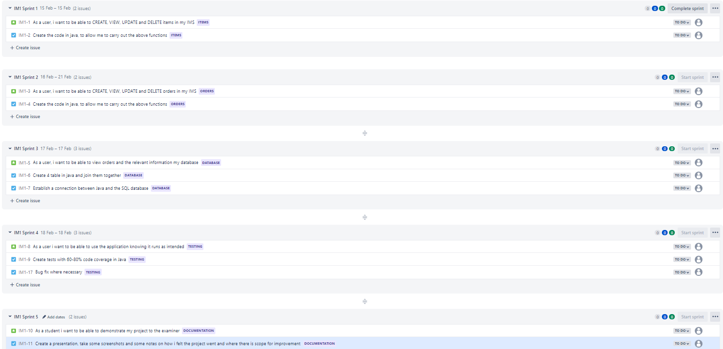
Kanban Board
Notes:
I tried to keep my user stories quite simple and condensed them, to not overcomplicate what I had to do
I chose to do these over 5 sprints. In a real world environment, I know that a sprint can take weeks as opposed to days.
Child issues (tasks) were created for each user story, which was what I needed to do to help keep me on track.
I did deviate somewhat with respect to using the Kanban board, as I was strongly focused on getting the application to work correctly. For future reference, I would stick to using agile practices and Jira to effectively plan my work.
Another function I had forgot to add to my user stories, were to be able to calculate the value of an order. In the future I should ensure that the project specification is correctly reflected in Jira.

Slide 4
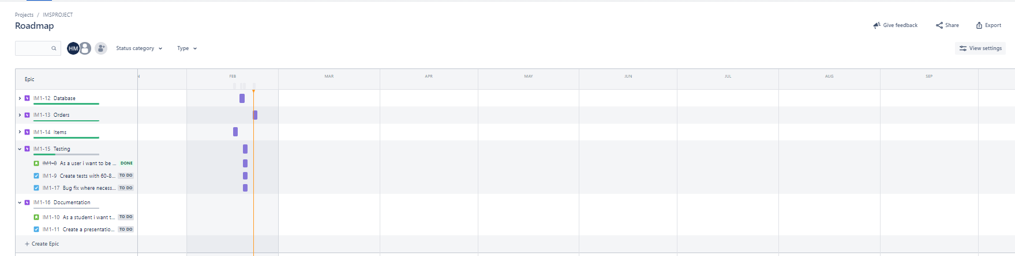
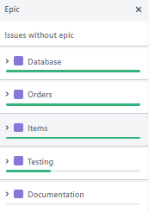
Sprints
Notes:
An overview of how the project went:
Managed to create CRUD functions for orders and items
Manged to create my database in SQL and have a connection to Eclipse.
I did not manage to get 60% test coverage, due to time constraints and knowledge.

Slide 5
The application
Will show some basic functionalities of the application being able to run
Some points to improve on from a user perspective:
Display all items available as part of order creation, as opposed to having to read the item list first.
Allow the user to add/delete multiple items by specifying the actual amount they wish to add/delete, as opposed to constantly deleting one by one.
Allow for the quantity of the items available to change, dependent upon how many are already in an order.
Some points to improve on from a developers perspective:
Gain a better understanding of switch cases as opposed to using multiple ‘else if’ statements
Make the database look more presentable and show all items in an order in one field

Slide 6
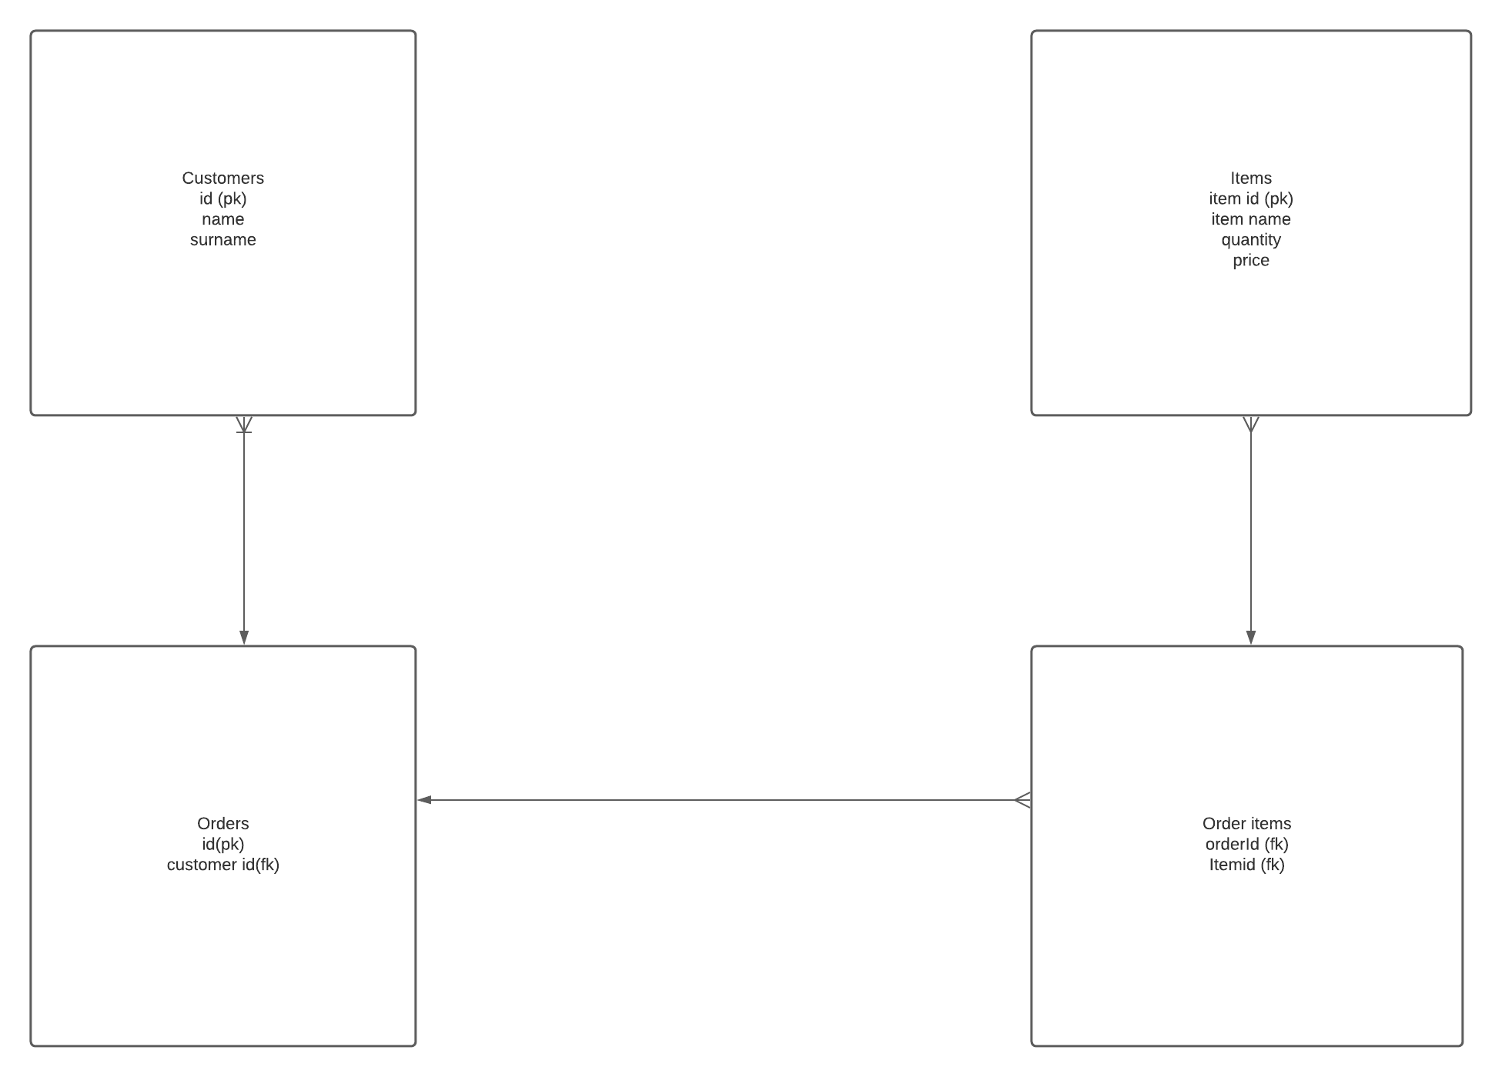
The ERD
Notes:
I initially started with a basic ERD to help me map out my SQL database and ultimately reflect these parameters in my working code.
However I had not paid great attention to this at the beginning, as my parameters had changed.
In the end I had to create a new ERD based on the parameters in SQL, as opposed to doing it the other way round

Slide 7
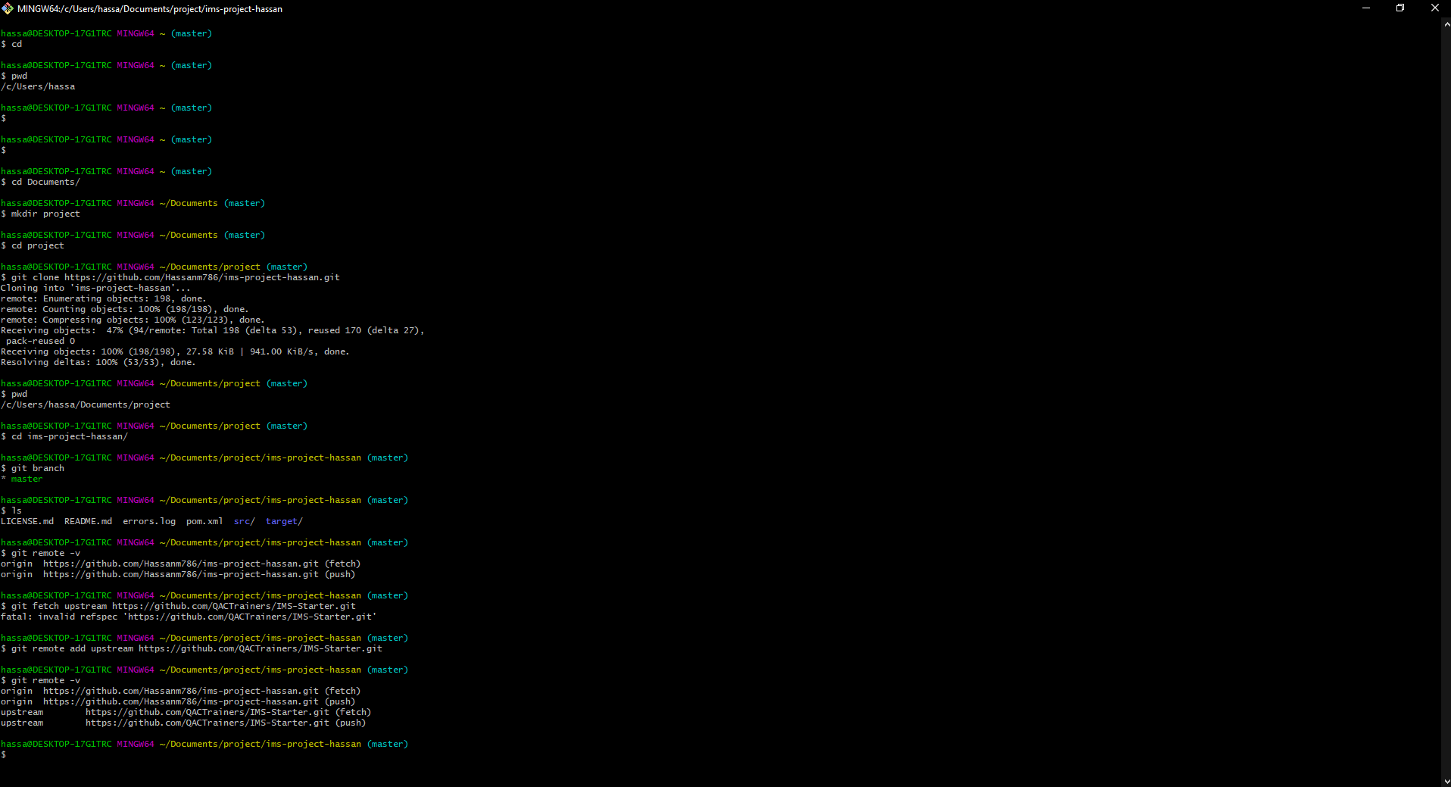
Git/Gitbash
Notes:
I had used git as a SCM and bash to upload all code to the remote repository, using the feature branch model
I initially had uploaded any changes at the beginning, however as the project went on I had not committed any changes that were made as per best practise
For future reference, I would commit any changes made to the code immediately.

Slide 8
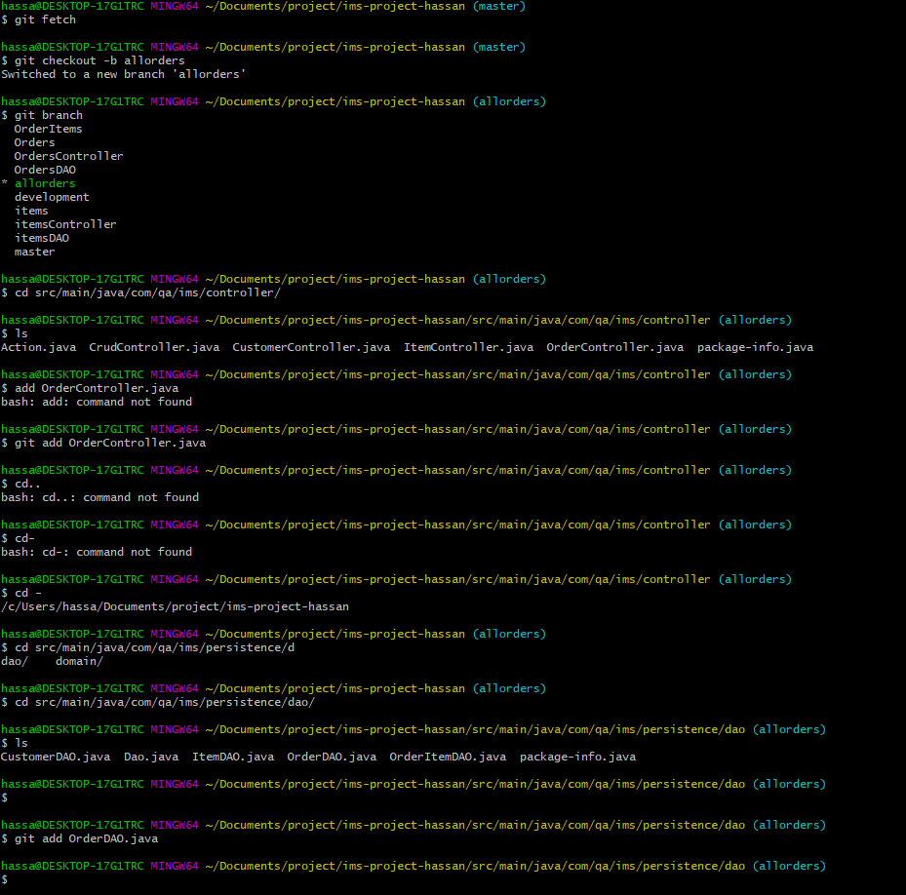

Slide 9
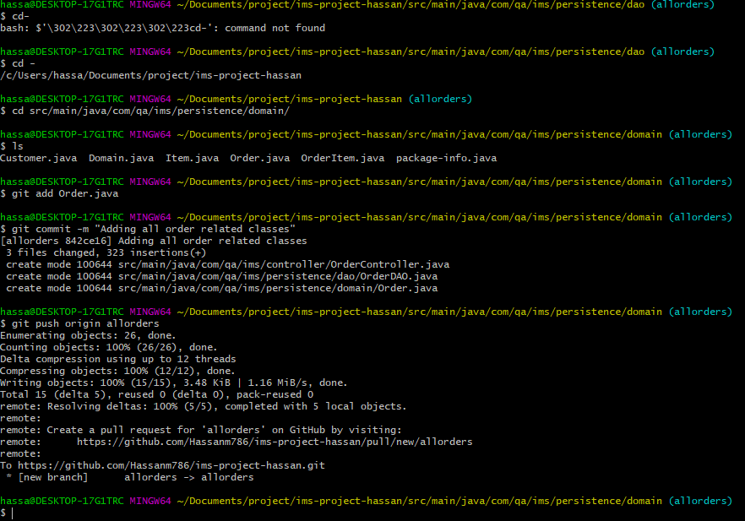

Slide 10
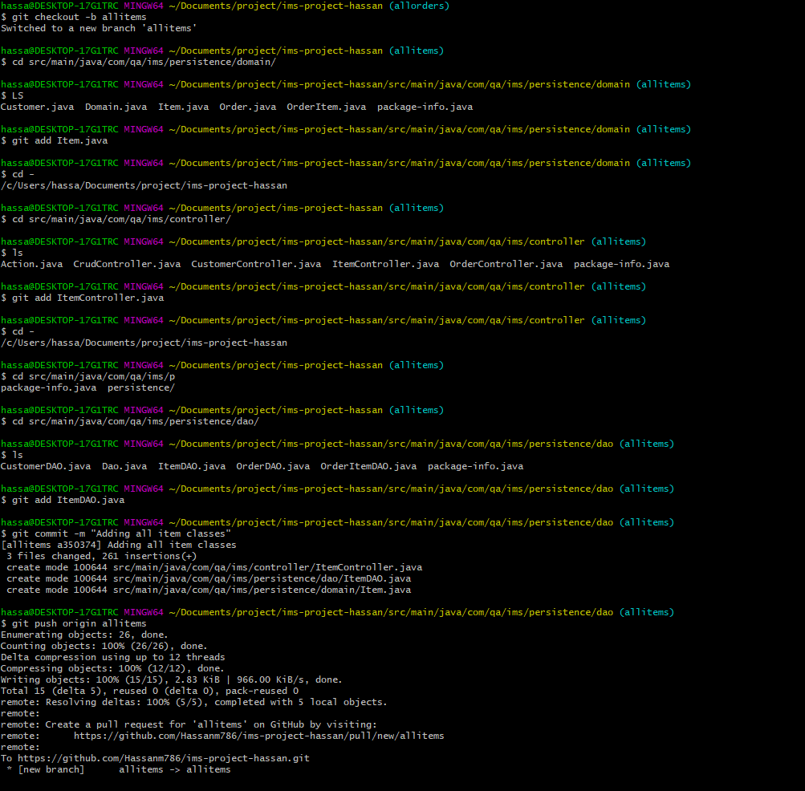
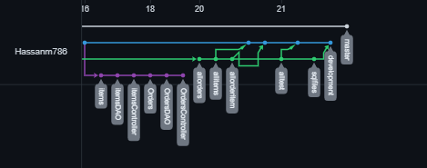
My dependency graph

Slide 11
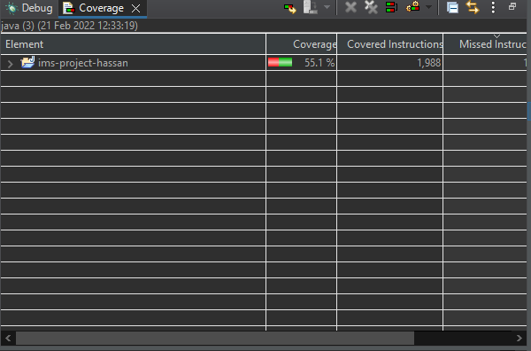
Testing
Notes:
I was able to achieve a total test coverage of 55.1% as opposed to my aim of 60-80%
These were mainly due to time constraints

Slide 12
Conclusion
Overall I felt the project went quite well, I managed to get a basic IMS running that achieved the specification
I definitely enjoyed this project and learnt a huge amount with regards to Java and database interaction
I also enjoyed going over my Git knowledge that we had learnt in the first week
Where I can definitely improve:
Be more organised and take advantage of support tools such as Jira and the use of ERD’s / risk assessments.
Be wary of time and try not to create the perfect code, but create something that is easy for the end user to use.
Increase my overall knowledge of Java, as this was a struggle to learn at a basic level.

